Slide 1

Data lake in AWS using Lake formation
VIKAS
Notes:
We plan to build a secure data lake on AWS using lake formation.

Slide 2
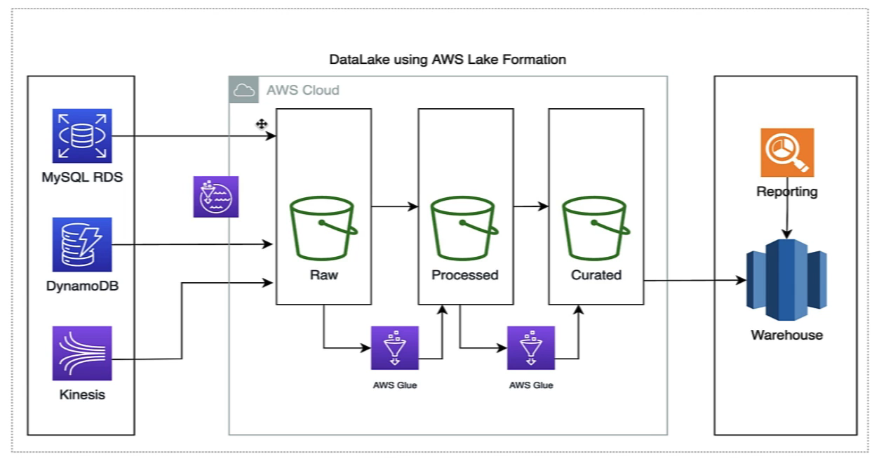
Notes:
Data lake keeps data in raw format

Slide 3
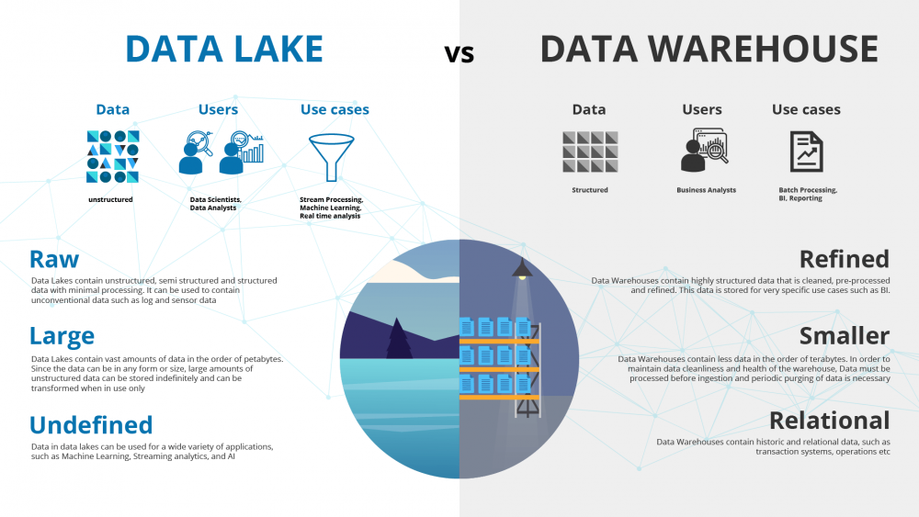
Notes:
Data lake setup involves a lot of processes which are complicated & time-consuming as you must load data from various sources and monitor their progress.
Set up partition , Look at the encryption part , manage keys, defining various transformation processes .
https://www.talend.com/resources/data-lake-vs-data-warehouse/

Slide 4
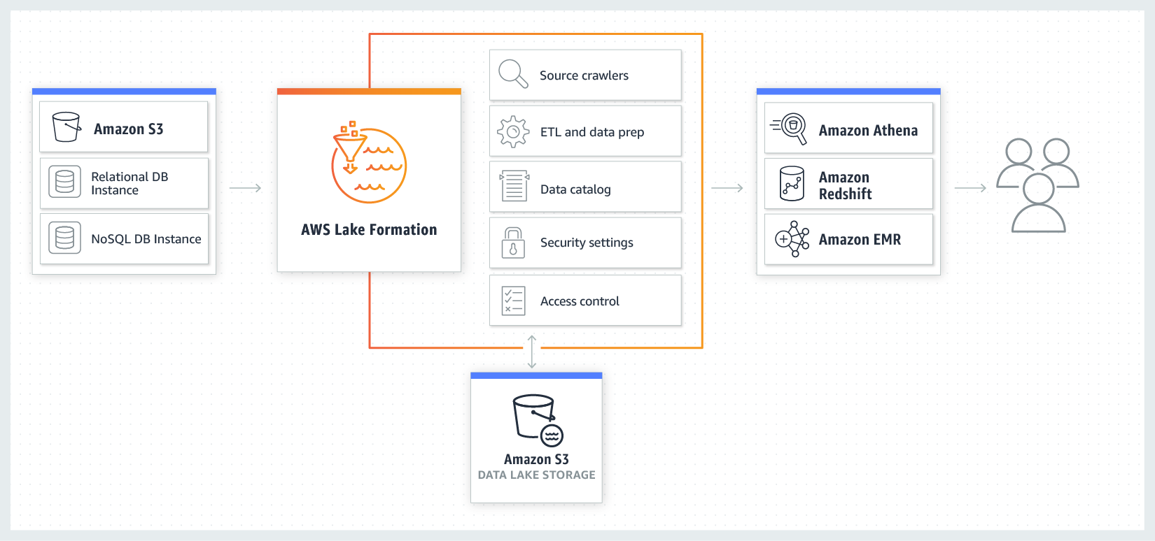
Notes:
What is AWS Lake Formation?
AWS Lake Formation is a fully managed service that makes creating, maintaining, and managing data lakes a breeze. AWS Lake Formation automates most of the data lake construction process, reducing the time it takes from months to weeks. The service acts as a single point of control for identifying, retrieving, cleaning, and transforming data from thousands of sources, as well as enforcing security regulations across various services and acquiring and managing fresh data. AWS Lake Formation is controlled via a single dashboard from which you can configure and alter all data lake lifecycle phases and operations.
Benefits:
Quickly creates data lakes
Simplifies security management
Provides self-service access to data

Slide 5
Pull Data from SQL (RDS)
https://downloads.mysql.com/docs/refman-8.0-en.pdf
Notes:
Create an IAM user with Administrator Access & AWS Lake Formation data Admin access.
Go to AWS Lake formation on the console and add the admin user.
GRANT DB access.
Create 3 S3 buckets enable encryption & versioning
In the raw bucket create three folders (input/customer, output, antenna)
Create 3 DB & link them to respective s3 bucket.
Add crawler -- > s3://raw/input/customer
Before running crawler -- > data lake permission -- > grant

Slide 6
Preparation & analysis of data – Glue Data Brew
Notes:
https://www.youtube.com/watch?v=DhuE1MiiL6I&t=596s

